Slide 1

Ontario Health Coalition
IF YOU ARE HAVING PROBLEMS
Instructions for fixing the sound or layout of the webinar - as you see it on your screen & hear it in your home - are coming in just a minute. Hold tight!
WEBINAR
on the Drummond Commission Report

Slide 2

Ontario Health Coalition
IF YOU HAVE A PROBLEM HEARING THE WEBINAR
If your computer normally plays sound you should be able to hear this webinar just fine. If the volume is too low, turn it up. Look for the volume icon near the bottom right of your computer screen. If that doesn’t work just plug in earphones or speakers into your computer. Look for the plug hole that has a little picture of earphones by it.
If your computer does not have sound, you will have to dial in to the dial in number provided when you registered in order to hear sound.
If you have dial up internet (versus wireless), you can log off your computer and dial into the dial in number. In this way you can hear the webinar just like a conference call but you won’t be able to see the presentation.
WEBINAR
on the Drummond Commission Report
If you need any technical assistance please dial
1-877-283-7062 for support.

Slide 3
Webinar “How Do I….”
Ontario Health Coalition
Make the box containing the video picture bigger or smaller?
In the bottom right corner of the box border around the video picture are three tiny dots. Left click on those dots to drag the box to a larger size or smaller size.
Ask a question?
In the grey horizontal bar near the top of your screen click on “Q&A” . You’ll see the space to type in your question there. We’ll answer questions as soon as we can get to it during the presentation or immediately after.
Move the box containing the video picture to the side.
You can move the window (box) that shows the video by clicking on the box and dragging your cursor across the screen. Left click your cursor on the black horizontal bar at the top of the box (window) that shows Natalie by video. Hold down your cursor and drag your mouse over to meet the right hand margin of your screen then let go.

Slide 4
This webinar is being recorded
Ontario Health Coalition
It will be available on our website by tonight at www.ontariohealthcoalition.ca

Slide 5
Yes. You can download your own copy of the power point presentation.
Ontario Health Coalition
It will be available on our website by tonight at www.ontariohealthcoalition.ca

Slide 6
HEALTH CARE FUNDING
SETTING THE CONTEXT
Major curtailment in funding proposed.
Government’s pre-election projections show >$3 billion in cost curtailment over next 2 – 3 years.
  Retrenchment would continue ‘til 2017-18 but breakdown of cost curtailment not available for remaining years.
Drummond recommends even lower funding projections.

Slide 7
Funding Background
SETTING THE CONTEXT
  Harris era (mid 1990s to early 2000s)
    Attempts to cut $1 billion from hospitals, actual cuts announced were $800 million
    Compounded with major funds redirected towards restructuring costs. Provincial Auditor reports $3.8 billion spent on restructuring costs to close hospitals & beds, move services, renovate, amalgamate and lay off staff.
  McGuinty early years
    Stablized funding, opened hospital beds, continued opening ltc beds (at a slower pace)
  McGuinty last 3 – 4 years
    Curtailment of hospital global budgets and changes to funding for hospitals in particular, also drugs–
      Global funding set below inflation
      A greater percentage of hospital funding special targeted funding for volumes and other targets

Slide 8
Funding Curtailment Means Cuts
SETTING THE CONTEXT
Ontario Auditor General’s Report shows >$3 billion cost carve-out at projected 3.6 % increase annually for 3 years:
>$1 billion to be carved out of hospital increases over next 2 – 3 years.
>$2.05 billion to be carved out of OHIP increases over next 2 – 3 years.
Home care funding growth to be less than 1/3 of what it has been for last 8 years.
Long-term care funding growth to be ½ of what it has been for last 8 years.
The Auditor warns that these targets are “aggressive”
Raises concerns about the existing wait lists in home and long-term care, and the viability of cutting hospital care to below population need.

Slide 9
Drummond Recommends Deeper Curtailment
SETTING THE CONTEXT
He recommends health care funding increases should be 2.5% not 3.6%. This amounts to a further funding curtailment of $500 million per year.

Slide 10
Creating A Crisis
SETTING THE CONTEXT
Drummond starts his Health Care chapter by stoking fears of health care eating up the provincial budget.
This claim is demonstrably false.
Health care is shrinking, not growing, as a proportion of our provincial budget spending.

Slide 11
SETTING THE CONTEXT
Year | Health Spending as % of Program Spending
2011 | 42
2008 | 46
2005 | 46
2002 | 47
Source: Ontario Budgets, Ministry of Finance, 2002, 2005, 2008, 2011

Slide 12
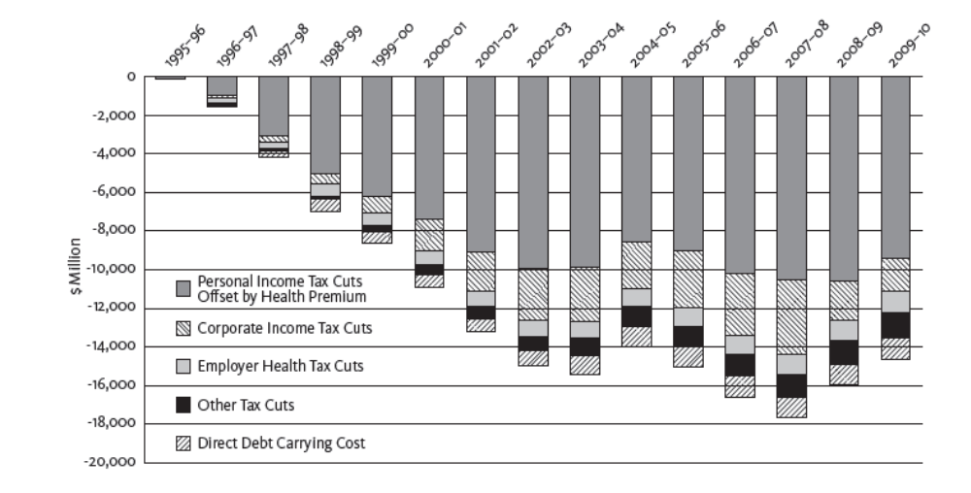
SETTING THE CONTEXT
A Closer Look at the Revenue Side:
Tax Cuts, Not Health Care are Eating Up the Provincial Budget
Annual Tax Cut Impact on Provincial Budget Capacity,
Ontario 1995-96 to 2009-10
Ontario has engaged in the most prolonged and deepest tax cuts of any province. These have mainly benefitted the highest income categories and corporations.

Slide 13
SETTING THE CONTEXT
Public Health Care Spending by Province – Per Capita 2010 Ontario 8th of 10 Provinces
Newfoundland | $ 4,982.9
Alberta | $ 4,762.9
Manitoba | $ 4,611.5
Saskatchewan | $ 4,602.1
PEI | $ 4,389.6
New Brunswick | $ 4,210.5
Nova Scotia | $ 4,192.9
Ontario | $ 3,911.7
British Columbia | $ 3,801.8
Quebec | $ 3,603.3
Tables 1 & 2 show Ontario’s health spending ranking; on a per-person basis and as a percentage of GDP. By both measures, Ontario ranks eighth out of ten provinces.
Public Health Care Spending by Province 2010 as a % of Provincial GDP Ontario 8th of 10 Provinces
PEI | 12.8
Nova Scotia | 11.0
New Brunswick | 10.8
Manitoba | 10.7
Newfoundland | 9.3
Quebec | 8.9
British Columbia | 8.5
Ontario | 8.4
Saskatchewan | 7.9
Alberta | 6.6
Compared to other provinces, Ontario spends $440 less per person on public health care. On an aggregate basis, this means Ontario spends $5.72 billion less on health care than other provinces.

Slide 14
SETTING THE CONTEXT
Hospitals are Shrinking, Not Growing

Slide 15
Ontario Hospital Beds Staffed and in Operation 1990 – 2010
Year | Acute | Psychiatric | Complex Continuing Care | Rehabilitation | Total
1990 | 33,403 | 2,505 | 11,435 | 2,048 | 49,391
1991 | 31,907 | 2,430 | 11,506 | 1,975 | 47,818
1992 | 29,826 | 2,331 | 11,425 | 1,902 | 45,484
1993 | 27,940 | 2,276 | 10,935 | 1,926 | 43,077
1994 | 26,097 | 2,166 | 10,592 | 1,905 | 40,760
1995 | 25,386 | 2,182 | 10,325 | 1,853 | 39,746
1996 | 24,014 | 2,147 | 9,639 | 1,890 | 37,690
1997 | 21,929 | 2,142 | 8,678 | 1,875 | 34,624
1998 | 20,317 | 2,094 | 8,149 | 1,815 | 32,375
1999 | 19,740 | 2,062 | 7,788 | 1,802 | 31,392
2000 | 19,558 | 2,505 | 7,505 | 1,924 | 31,492
2001 | 19,912 | 3,444 | 7,455 | 2,137 | 32,948
2002 | 19,355 | 3,709 | 7,428 | 2,240 | 32,732
2003 | 18,781 | 3,620 | 6,896 | 2,349 | 31,646
2004 | 18,552 | 4,547 | 6,537 | 2,362 | 31,998
2005 | 18,433 | 4,511 | 6,402 | 2,397 | 31,743
2006 | 18,444 | 4,368 | 6,094 | 2,478 | 31,384
2007 | 18,445 | 4,305 | 5,972 | 2,415 | 31,137
2008 | 18,702 | 4,333 | 6,039 | 2,410 | 31,484
2009 | 18,773 | 4,332 | 5,927 | 2,392 | 31,424
2010 | 18,355 | 4,335 | 5,798 | 2,322 | 30,810
Difference 1990 - 2010 | -15,048 | +1,830 | -5,637 | +274 | - 18,581
Difference | - 45% | + 73% | - 49% | + 13% | - 38%
18,500 Ontario hospital beds have been cut since 1990
^{[1]} Source: Ontario Hospital Association a
t http://www.healthsystemfacts.com/Client/OHA/HSF_LP4W_LND_WebStation.nsf/page/Beds+staffed+and+in+operation+Ontario+1990+to+large

Slide 16
SETTING THE CONTEXT
Home Care Funding Shrinking, Not Growing, as % of Health Care Budget
Source: Ontario Auditor, 2010.

Slide 17
Urgent and Unmet Care Needs Across the Continuum
SETTING THE CONTEXT
More than 30,000 Ontarians are waiting for a hospital bed, long-term care placement or home care.
24,000 Ontarians are on wait lists for long-term care placement.
10,000 Ontarians are on wait lists for home care.
Ontario has cut hospital beds to the point that we have the fewest beds per person in the country.
  At any given time, 592 Ontarians are waiting in emergency departments for hospital beds.
  2, 271 Alternate Level of Care (ALC) patients are waiting in hospital for a long-term care bed.
  773 Alternate Level of Care (ALC) patients are waiting in hospital for another type of hospital bed.
  135 Alternate Level of Care (ALC) patients are waiting in hospital for home care.
Ontario ranks at the bottom of comparable jurisdictions in emergency department wait times, a key indicator of hospital bed shortages.
Wait times for long-term care and home care are at or above the high levels of the late 1990s.
Home care funding per client declined by 14% between 2003 and 2009.

Slide 18
Drummond’s Primary Recommendation
DRUMMOND’S RECOMMENDATIONS
Cap health care funding at 2.5% annual growth through to 2017 – 18.
No connection between recommendations and measuring/meeting population need for care.
Access to care is not considered in his report.
Drummond himself reported that his spending targets were more severe and prolonged than even under the Harris government.

Slide 19
Dismantle Hospitals
Drummond’s Recommendations
Drummond’s vision, if implemented, would mean the death of community hospitals. His report repeatedly recommends that hospitals and hospital services be cut and privatized; virtually all services be removed and contracted out.
Cut hospital services and privatize them. “Divert all patients not requiring acute care from hospitals,” to other places provided by private for-profit or non-profit entities.
No role for complex continuing care, rehab, palliative care, outpatient clinics, mental health services, and a whole range of other hospital services.
He expressly recommends that all plans for hospital buildings that involve outpatient services be stopped and private operators be contracted for outpatient services.
Centralize services into fewer sites.
Bring in specialized clinics (hospitals), specialize all hospitals. Patients would have to travel from site to site to access care.
Amalgamate more hospitals and/or their boards.
Bring in private-sector managers to manage costs for complex patients.
Move to fee-for-service hospital funding model and force hospitals to compete.
Force specialists to bid for funding.
“Redefine the role” of smaller hospitals with large ALC populations. (Drummond mis-defines ALC in his report.)

Slide 20
Stop Building Long-Term Care Homes
Drummond’s Recommendations
Place a moratorium on building long-term care homes.
Note: there are 36,000 currently on the wait list across Ontario. 24,000 are waiting for a placement. 12,000 are waiting for a transfer out of a facility that is not of their choice (spouses trying to be reunited, people out of their home community trying to get back, people who don’t like the facility they are in)

Slide 21
Mergers and Amalgamations
Drummond’s Recommendations
Reduce the number of health care providers by amalgamating more hospitals, creating one entity to represent long-term care homes (for-profit and non-profit/public), amalgamating and closing health service agencies and/or their boards.
Possibly merge or somehow tightly integrate LHINs and CCACs.

Slide 22
Primary Care/HR
Drummond’s Recommendations
Restructure Family Health Teams.
Tough bargaining stance with doctors.
More nurse practitioners, physician assistants, train more nurses.
Use the health care team to its full scope.
Move more physicians to family health teams.

Slide 23
LHINs
Drummond’s Recommendations
Give more power to LHINs including budget powers and powers over a wider range of providers.
Reconstitute the LHINs with more powers and higher CEO salaries.
Establish Advisory Panels (paid) recruited from executives of hospitals, long-term care homes, community care and physicians (without regard to their for-profit, non-profit status).
LHINs should steer patients to share them among family health teams. (No details)
No democracy in any proposals for health care planning bodies.

Slide 24
Funding
Drummond’s Recommendations
Aside from the cutbacks, Drummond proposes changing funding mechanisms in a variety of ways.
Many of these are contradictory.
Hospitals move to fee-for-service competition model. But he also recommends a new global funding system called HBAM (which is the opposite of fee-for-service).
Move more physicians off of fee-for-service to a blend of salary/capitation (pop based) and fee-for-service funding.
Move OHIP coverage decisions away from OMA/provincial bargaining.

Slide 25
Privatization
Drummond’s Recommendations
Privatize the full range of hospital services
  Private for-profit acute care clinics (hospitals)
  Private for-profit outpatient services (all of them)
  Private for-profit provision of any or all non-acute care services
Privatized home care
Private (for-profit) LHIN advisory committees
Private sector managers for complex patients.

Slide 26
Drugs
Drummond’s Recommendations
Contain the cost of drugs.
Support national pharmacare, joint purchasing etc.
Change the ODB to get rid of universality.
Limit payments for drugs to “wealthy” seniors.
Increase co-payments.
End the current system and create a new means-tested program.
Not clear on the implications for the Trillium Drug Program.

Slide 27
Costing
Drummond’s Recommendations
The Drummond Report does not contain any costing of the health care proposals.
There are no planned restructuring funds.
  The last restructuring cost >$3.8 billion.

Slide 28
Alternatives
Drummond’s Recommendations
Look at revenues
  Employer Health Tax
  Others
Reforms that put public values in public non-profit health care, universality, accessibility at the centre of plans.
  Improve accountability.
  Ensure money goes to care.
  Protect publicly funded and public/non-profit care under the principles of the Canada Health Act.

Slide 29
Responding to Drummond
What’s Next
Ontario Health Coalition upcoming report with recommendations that respect the public interest (vs. the Drummond approach)

Slide 30
OHC EMERGENCY ASSEMBLY
What’s Next
Saturday, February 25th
11 am – 4 pm (lunch provided)
Church of the Holy Trinity, Toronto
10 Trinity Square
(beside the Eaton Centre just outside
Indigo Books)
Hotel rooms: We have reserved a block of rooms at the Bond Place Hotel, 65 Dundas St. E., at a rate of $89 per night. To get this rate, call 1-800-268-9390 and cite “Ontario Health Coalition”.
Please register for the assembly by emailing us at ohc@sympatico.ca

