Slide 1
Public Health Care on Trial: the Cambie Ruling
Usman Mushtaq, Coordinator

Slide 2
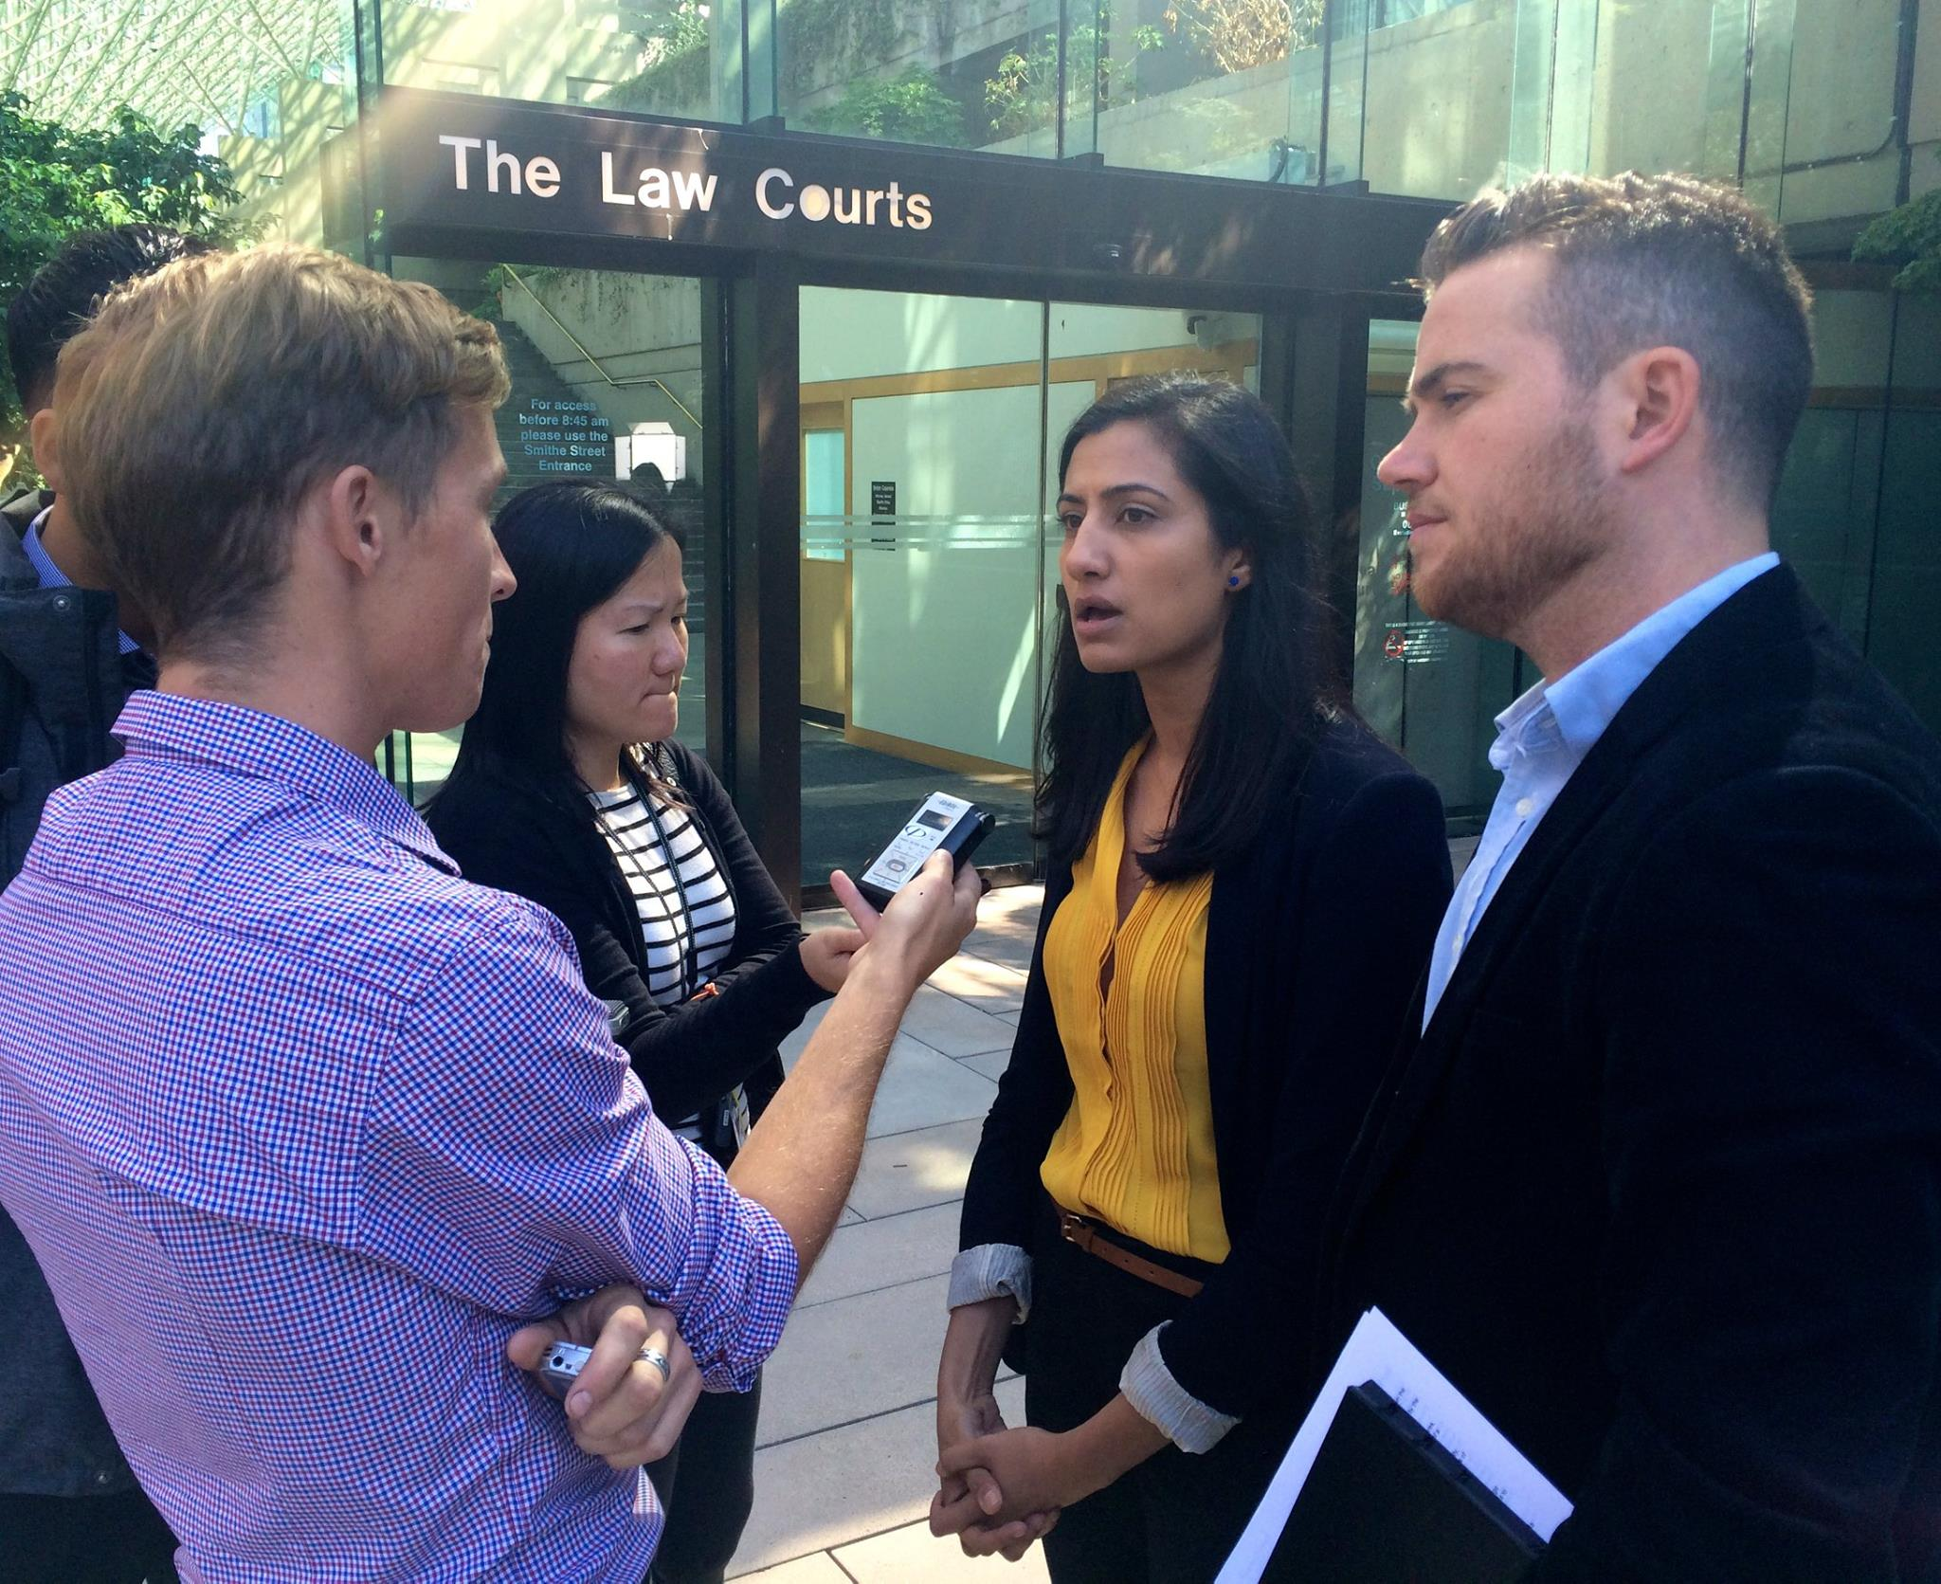
About the BCHC
A Decade of Advocacy

Slide 3
About the BCHC
We Won!

Slide 4
The sections of the Medicare Protection Act that the plaintiffs are challenging are:
Section 14: Election (enrolled doctors can opt out and bill the patient instead of the Medical Services Plan; in these cases, the patient applies for reimbursement from MSP and the physician cannot bill both the patient and MSP for the same service; enrolled doctors also cannot bill above the tariff negotiated between the government and Doctors of BC);
Section 17: General limits on direct or extra billing (an enrolled and opted-in physician cannot bill a patient directly for a service included in MSP, or for “materials, consultations, procedures, use of an office, clinic or other place or for any other matters that relate to the rendering of a benefit”);
Section 18: Limits on direct or extra billing by a medical practitioner (enrolled and unenrolled physicians who practise in a public hospital or community care facility may not bill more than the tariff negotiated between the government and Doctors of BC; this restriction does not apply to unenrolled physicians practising in a nonhospital facility); and,
Section 45: Private insurers (physicians may not charge private insurers for a service included in the Medical Services Plan; only applies to physicians who are enrolled in the MSP).
About the BCHC
What is being challenged?

Slide 5
How does BC’s Medical Protection Act relate to the Canada Health Act?
Provincial laws, including the challenged provisions in the Medical Protections Act, are designed to be consistent with the criteria of the Canada Health Act.
At the federal level, the Canada Health Act lays out the conditions—including a ban on extra-billing and user fees—that each province must meet to receive federal cash transfers for health.
No matter what the decision is this summer, this case is almost certain to advance to the Supreme Court of Canada.

Slide 6
Canada’s Medicare system will transform into a US-style system:
About the BCHC
We share a border with the U.S
Until the implementation of Canada’s single payer system the U.S. and Canadian health care financing systems were nearly identical.
Canada’s doctors share a medical culture with U.S. doctors
USMCA indicates that if private provision and insurance is allowed, U.S firms should be able to compete.
American health care companies spent nearly $568 million on lobbying in 2018 alone more than any other industry in the US.
Weight of Canadian and international research clearly shows that private financing increases wait times for those waiting in the public system.
If we lose...

Slide 7
[15] “...the introduction of duplicative private healthcare would increase demand for public care, reduce the capacity of the public system to offer medical care, increase the public system’s costs, create perverse incentives for physicians, increase the risk of ethical lapses related to conflicts between the private and public practices of physicians, undermine political support for the public system, and exacerbate inequity in access to medically necessary care. Indeed, it would create a second tier of preferential healthcare where access is contingent on a person’s ability to pay.”
About the BCHC
The Decision

Slide 8
About the BCHC
Key Points
in the
Decision

Slide 9
About the BCHC
Impacts

Slide 10
About the BCHC
Next Steps

Slide 11
About the BCHC
Thank You

Slide 12
About the BCHC
Usman Mushtaq, Coordinator
usman@bchealthcoalition.ca
604-349-9079
Find us at
www.bchealthcoalition.ca
www.savemedicare.ca
Questions?

