Slide 1
Human Rights, Discrimination Against the Elderly and
Ontario Health Cuts
Ontario Health Coalition Symposium
Saturday, October 24, 2020
Gary R. Will
Will Davidson LLP
www.willdavidson.ca

Slide 2
What Have We Learned
Failed our seniors
Has been a problem for decades
Covid-19 has put a spotlight on problem

Slide 3
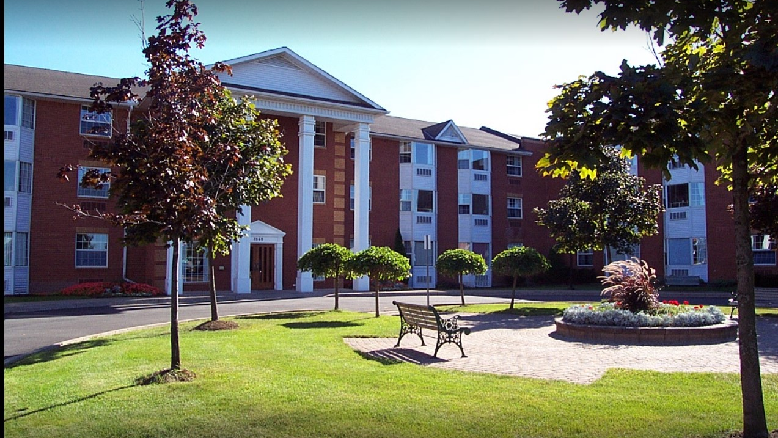
Lundy Manor – 19 Deaths + 45 Infections

Slide 4

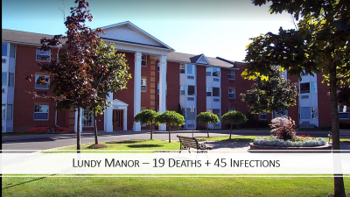
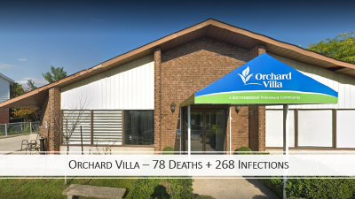
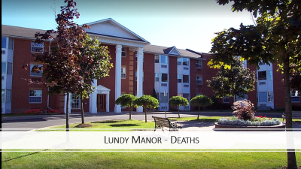

Slide 5
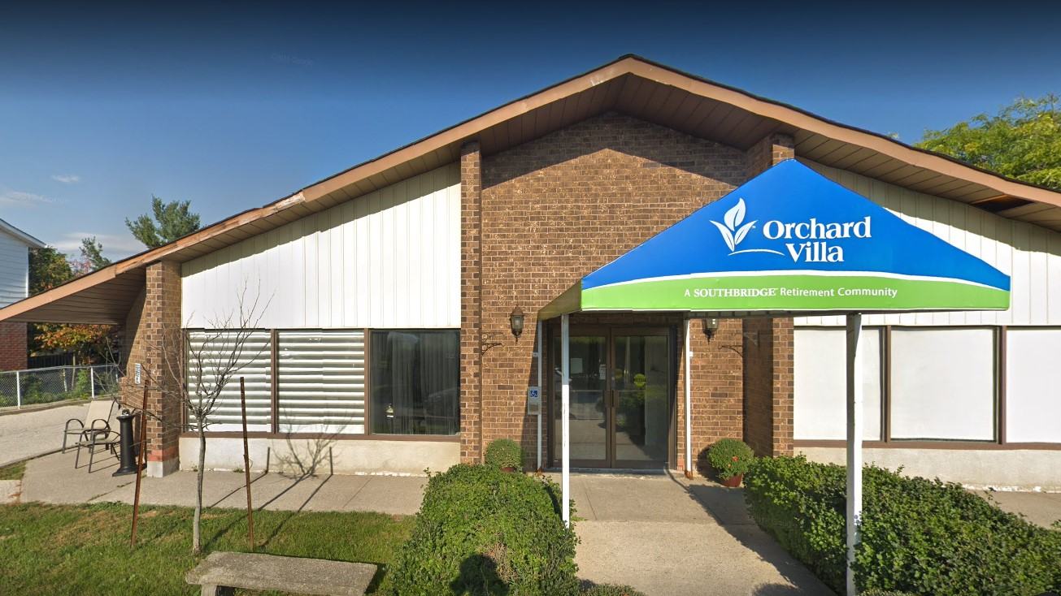
Orchard Villa – 78 Deaths + 268 Infections

Slide 6
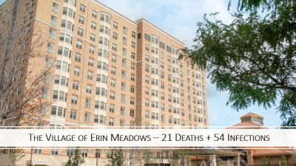


Slide 7
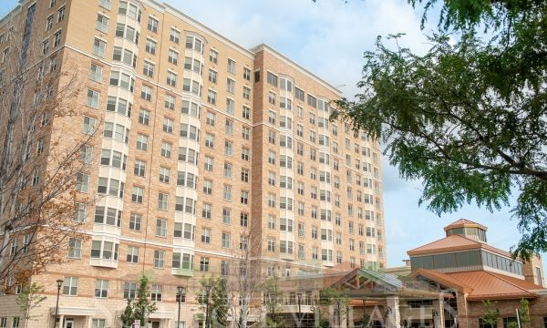
The Village of Erin Meadows – 21 Deaths + 54 Infections

Slide 8
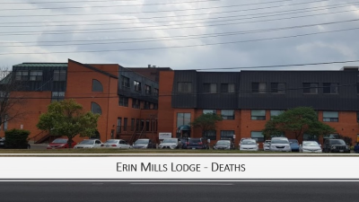
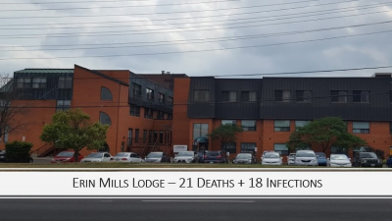

Slide 9
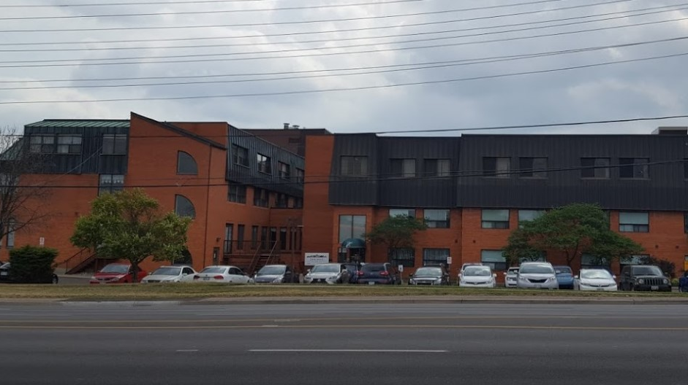
Erin Mills Lodge – 21 Deaths + 18 Infections

Slide 10
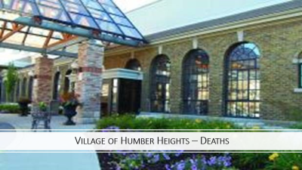
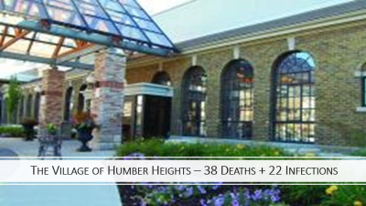

Slide 11
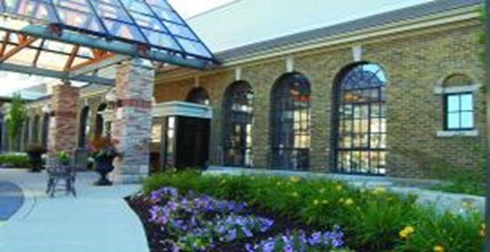
The Village of Humber Heights – 38 Deaths + 22 Infections

Slide 12
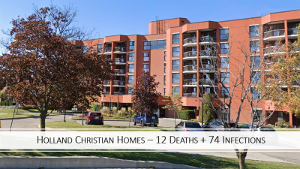


Slide 13
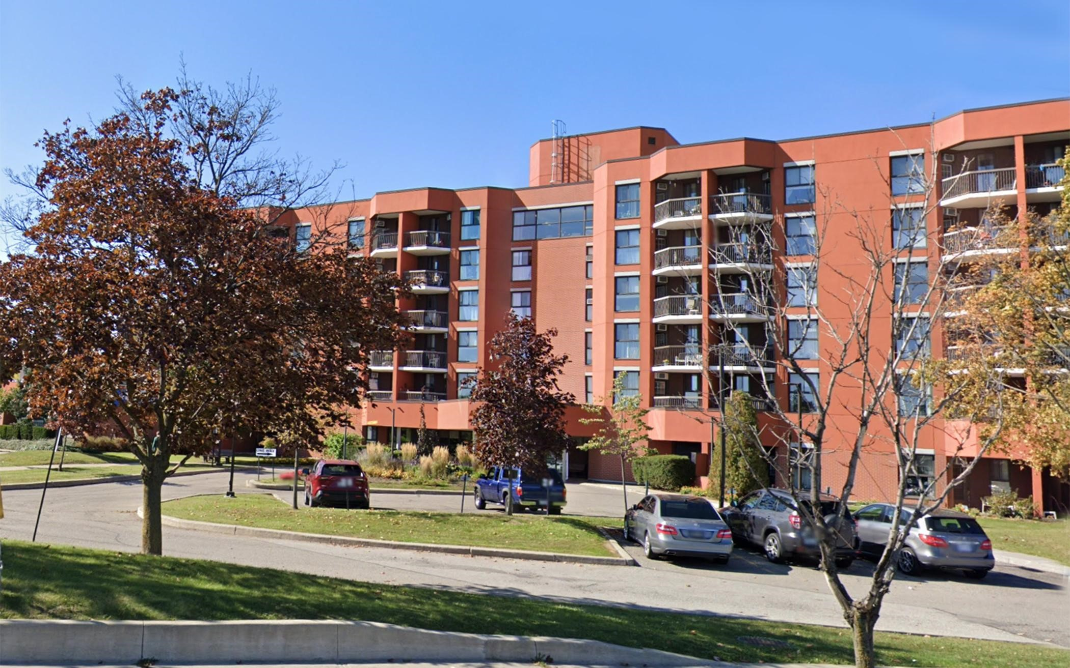
Holland Christian Homes – 12 Deaths + 74 Infections

Slide 14
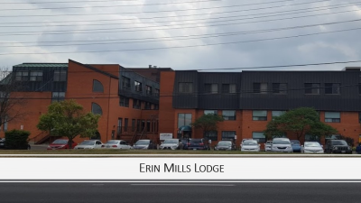
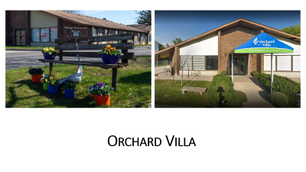



Slide 15
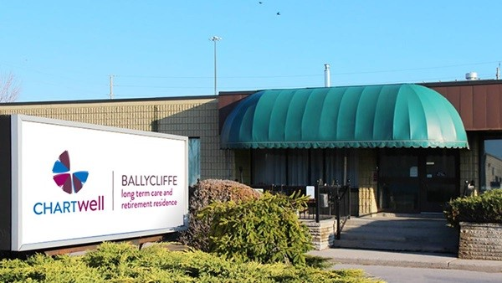
Ballycliffe Chartwell – 31 Deaths + 78 Infections

Slide 16
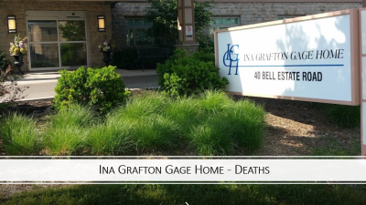
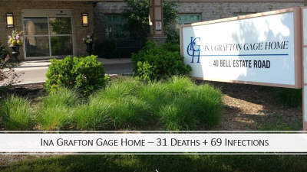



Slide 17
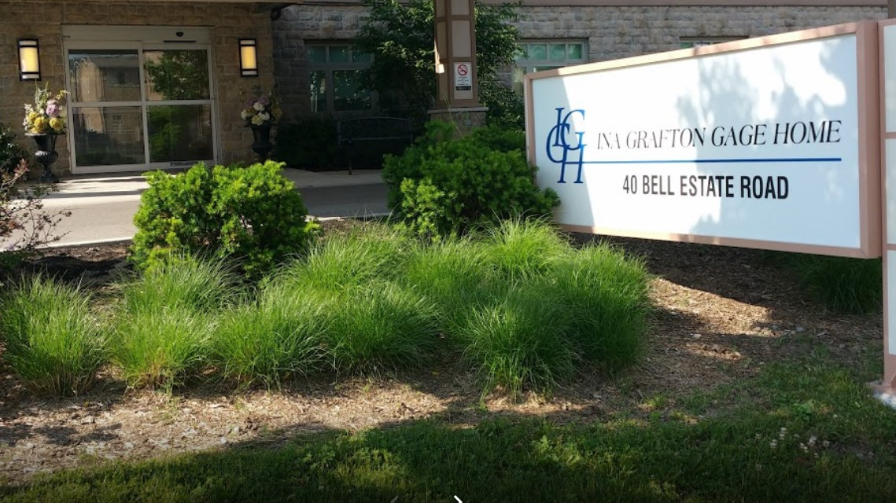
Ina Grafton Gage Home – 31 Deaths + 69 Infections

Slide 18


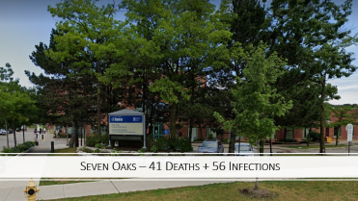



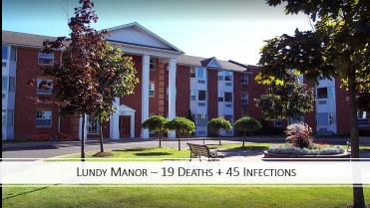

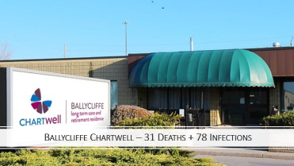



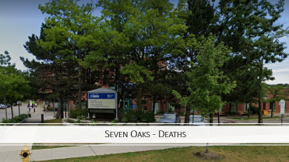
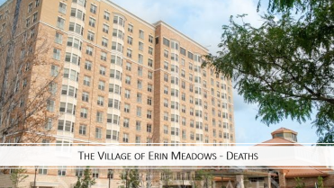
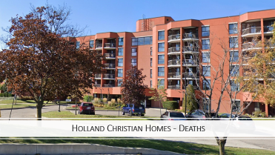
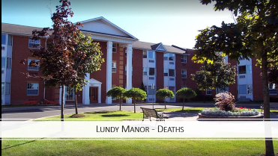

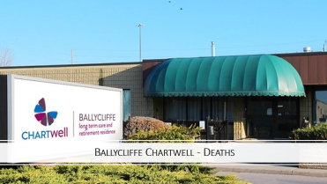

Slide 19
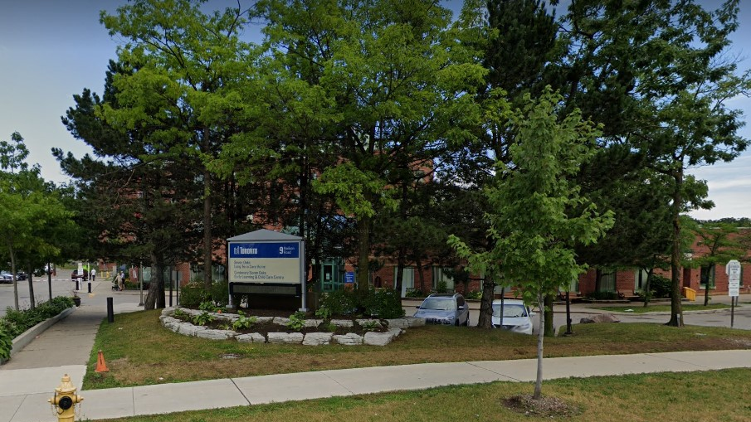
Seven Oaks – 41 Deaths + 56 Infections

Slide 20
History of Orchard Villa
Before 2015 owned and managed by Lafontaine family
Sold to Southbridge Healthcare, a large American company, in 2015
Extendicare Inc. hired to manage Orchard Villa in 2015

Slide 21
Extendicare Inc.
A large multi-national corporation
Before 2012, manage and own large number of homes in US
2013 charged by US Department of Justice under False Claims Act
Billed Medicare for services so deficient effectively worthless

Slide 22
Extendicare Inc.
October 2014 Extendicare pays $38 Million to settle case
Largest failure of care settlement in US Justice Department’s history
Entered a five year corporate integrity agreement

Slide 23
Extendicare Inc.
November 7, 2014 sells entire American portfolio for $870 Million
Plan was to grow and expand business in Canada
Major move into Ontario
Southbridge described Extendicare as recognized leader in quality clinically based services

Slide 24
Orchard Villa 2017 to 2019
19 investigations by Ministry of Health and Long Term Care
Over 43 days at Orchard Villa investigating complaints
65 written warnings
32 voluntary plans of correction
13 compliance Orders
3 matters referred to Director

Slide 25
Doug Ford Press Conference
May 26, 2020
Talks about Canadian Forces Report
Described facts as heartbreaking and gut wrenching
Appalling and disgusting
Most heart wrenching report he had ever read
Results of investigation would be released to police and prosecutors

Slide 26
Doug Ford Press Conference
May 26, 2020
There will be accountability for these nursing homes
There will be justice for the residents and their families

Slide 27
Accountability
As of October 2020
No charges laid
No one has been fined
Bill 218 shields wrongdoers from responsibility for negligence

Slide 28
Justice for Residents and Families
Proceedings for negligence barred
All existing proceedings for negligence dismissed without costs
No compensation payable for extinguishment or termination of rights

Slide 29
Government Says Consulted Widely
Before Introducing Legislation
But with who
Not the Ontario Health Coalition
Not with residents or families
Not with legal organizations
Not with consumer advocacy groups

Slide 30
Government Consulted Widely
With Insurance Bureau of Canada
Long term care homes and their lobbyists

Slide 31

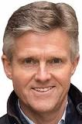

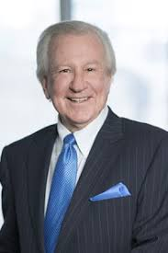

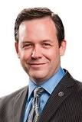
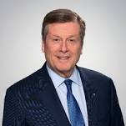
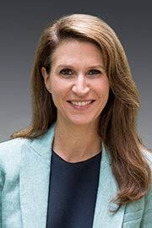
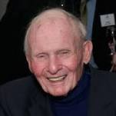
Connections Between Conservative Party and LTCH Lobby
Andrew Brander
Former Director of Communications
Current Lobbyist for OLTCA
Leslie Noble
Former Campaign Manager
Current Lobbyist for Chartwell
Brenda Akers
Former Director of Communication
Current Lobbyist for Sienna
Rod Phillips
Finance Minister
Mike Harris
Former Premier (1995-2002)
Current Chair of Chartwell
Greg Rickford
Minister of Energy
Ernie Eves
Former Premier
Current Board of Central Park Lodges
Melisa Lantsman
Former War Room Director
Current Lobbyist for Extendicare
Doug Ford
Premier
Doug Downey
Attorney General
Michael Wilson
Former Chief-of-Staff
Current lobbyist for Sienna
Lauren McDonald
Former Director of Marketing
Current Lobbyist for Revera
John Tory
Former Leader PC Party
Caroline Mulroney
Minister of Transportation
Donna Duncan
Former Policy Advisor
Current CEO of OLTCA
William Davis
Former Premier
Current Board of Revera
Christopher Chapin
Former Senior Campaign Advisor
Current Lobbyist for Caressant Care

