Slide 1

The Ontario Fiscal Situation, the Economy, and health care
Report to the Ontario Health Coalition Assembly
Doug Allan, October 25, 2020
COPE491/ND

Slide 2
Ontario funding has fallen far behind

Slide 3
It wasn’t always thus…

Slide 4
Same for overall health care funding

Slide 5
Hospital underfunding accounts for 69% of the gap

Slide 6
Whole series of effects…

Slide 7
Fewer admissions

Slide 8
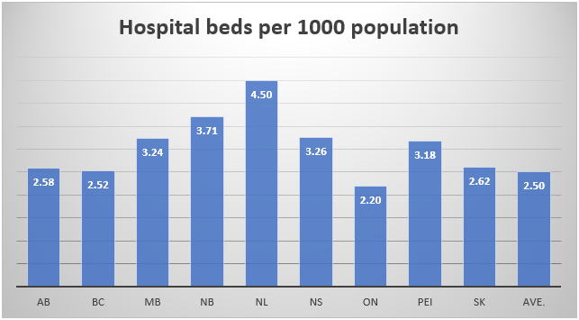
Fewer hospital beds

Slide 9
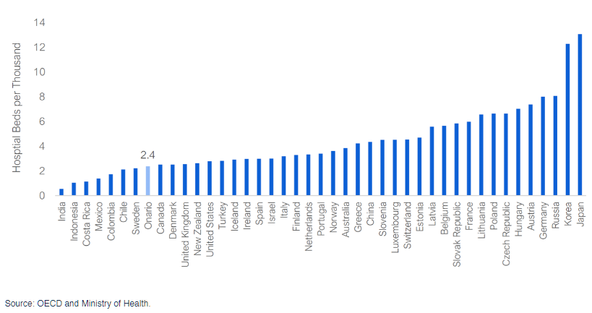
Few beds on international basis

Slide 10
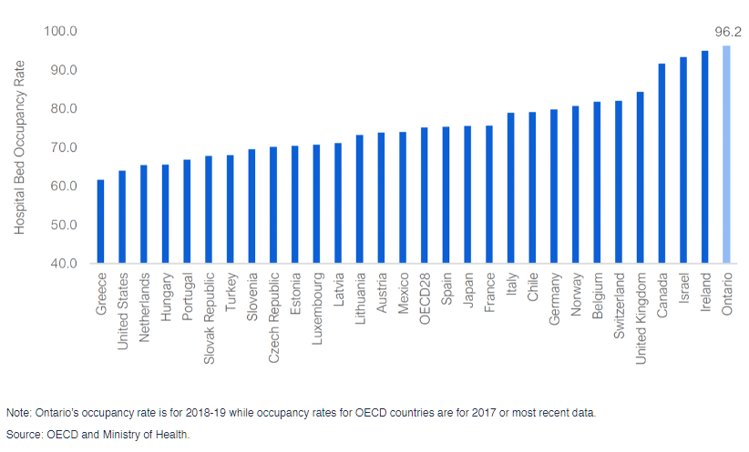
Very high bed occupancy

Slide 11
Fewer hospital employees

Slide 12
Shorter length of stay

Slide 13
Rising readmissions and high sepsis rate
Hospital re-admissions continue to increase. In 2012-13, 30-day hospital re-admissions were 8.9 per 1000 patients but rose to 9.6 in 2018-19 according to CIHI. This is a 7.6% increase in six years. The Ontario re-admission rate is 2.1% higher than the Canadian average.
The in-hospital sepsis rate is 17.9% higher in Ontario hospitals than the Canadian average.

Slide 14
Low LTC staffing

Slide 15
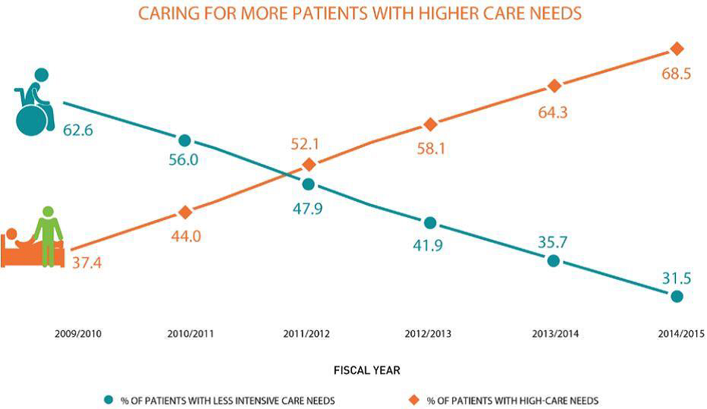
Home care distress
One-third of long-term home care patients had unpaid caregivers who experienced distress, anger or depression in relation to their caregiving role, or who were unable to continue in that role. That rate of distress even in 2013-14 had more than doubled from 15.6% just four years earlier. Over the same period, the proportion of patients with caregivers who were not able to continue looking after them also more than doubled, to 13.8% from 6.6%.

Slide 16
COVID-19: Huge program spending increase budgeted
Planned program spending in 2020-21 of $174.2 billion is $19.9 billion higher than actual 2019-20 program spending of $152.3 billion.
If implemented that would be a WHOPPING 14.4% increase.

Slide 17
But, but, but…
The $19.9 billion increase includes approximately $9.3 billion in program spending for 2020-21 that has yet to be allocated to actual programs.
Specifically:
$6.7 billion from the COVID-19 Health Sector Response Fund and the Support for People and Jobs Fund.
$2.6 billion increase in the standard Contingency Fund.

Slide 18
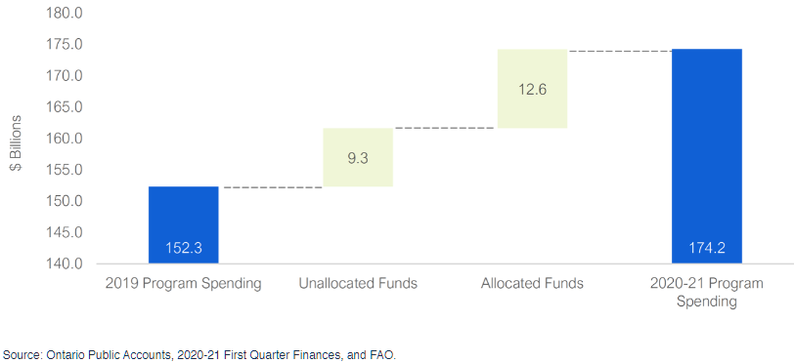
$9.3 billion in unallocated program spending

Slide 19
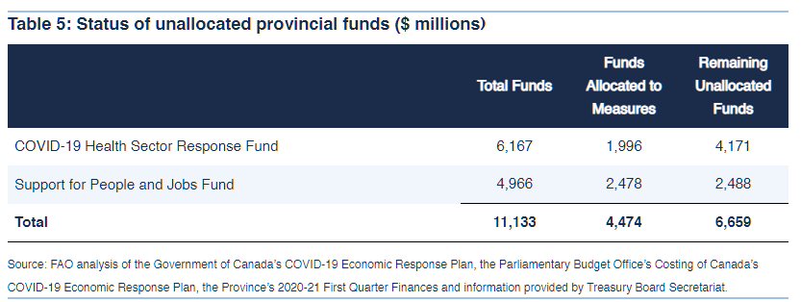
Unallocated special funds as reported by FAO on September 10

Slide 20
Health budget up
$67.7 billion budgeted.
Up $4.2 billion or 6.6% over 2019-20 actual health care spend.
But there is more available – through special funds, especially COVID-19 Health Sector Support Fund, which was set at $6.167 billion.
As noted, a lot of the special funds have not been allocated – and may never be allocated.

Slide 21
Federal government provides much of the extra COVID funding to the province
FAO: “A total of 126 federal and provincial direct support measures will provide Ontario with a net total of $105.6 billion in support in 2019-20 and 2020-21, including 61 federal measures totalling $102.0 billion and 65 provincial measures totalling $10.8 billion. Although the FAO identified $10.8 billion in provincial measures, the net cost to the Province is only $3.6 billion after accounting for federal cash transfers to the Ontario government of $7.2 billion.”

Slide 22
In-year spending in the first quarter of 2020-21
Financial Accountability Office report
At $37.9 billion, spending in the first quarter of 2020-21 was $4.0 billion, or 11.9 per cent,
higher than in the first quarter of 2019-20. The vast majority of the year-over-year spending increase (94 per cent) occurred in two sectors: health ($1.5 billion) and education ($2.3 billion).
The increased spending in the education sector, however, is just an accounting issue that will be reversed in the 3rd quarter.
The $1.5 billion (or 10.6 per cent) increase in health sector spending, compared to the first quarter of 2019-20, reflects the government’s response to the COVID-19 pandemic.

Slide 23
In-Year spending – 1st quarter (Cont’d)
Over the first three months of the 2020-21 fiscal year, the Province spent $37.9 billion. Overall, this is $0.7 billion,
or 1.9%, more than the (revised) plan. However, this is more than accounted for by the extra spend on education, which, is only a temporary accounting issue. All other sectors spent less than the revised budget planned.
Health sector spending: $179 million below the revised plan through the first quarter, including: $161 million above plan in Long-Term Care Homes Program. $132 million above plan in Drug Programs. $123 million below plan in Population and Public Health, which funds public health agencies and other public health measures. $291 million below plan in Ontario Health Insurance.
Hospital operations spending over the quarter was $5.33 billion, or 26.6% of the annual hospital operations revised spending plan – a little above 25%.

Slide 24
Overall funding increase will likely be less than advertised
Whether the PCs will actually spend all of this is however doubtful. A big portion of the increased funding was placed into special funds (a COVID-19 fund and a Support for People and Jobs fund) which may or may not be spent. The FAO reports that $6.7 billion of those special funds had not even been allocated, never mind spent.

Slide 25
Likely less (Continued)
Setting aside a temporary increase in education spending (which will be made even in the 3rd quarter), the PCs spent $1.6 billion less than budgeted in the first quarter of 2020-21 according to the FAO.
On an annualised basis that would mean spending $6.4 billion less than budgeted
Underspend may become even larger as government’s appetite for dealing with COVID appears to be diminishing

Slide 26
Health care has received significant funding increase through the first quarter
Nevertheless, heath care received a $1.5 billion increase in spending in the first quarter compared to last year’s first quarter.
That is a 10.6% increase over the first quarter of 2019-20
Again, however, appetite for spending appears to be diminishing as year wears on

Slide 27
Ontario Deficit Sky-rocketing
The deficit budgeted to increase to $37.2 billion this fiscal year according to FAO. Next year: $20.4 billion.
Government tax revenue forecast to fall $12.1 billion this fiscal year.
Contrast $37.2 billion deficit with $8.7 billion deficit in 2019-20 (a deficit the government used to justify 1% wage cap for the BPS)
Deficit may end up to be smaller – as often occurs
Nevertheless, it will be very large

Slide 28
Debt Sky-Rocketing
The FAO projects net debt to increase by $47.4 billion in 2020-21 and by a further $23.8 billion in 2021-22. Total two year increase = $71.1 billion.
If so, the debt to GDP ratio will increase to 47.8%, far above the level hit during the 1991-2 and 2008-9 recessions.

Slide 29

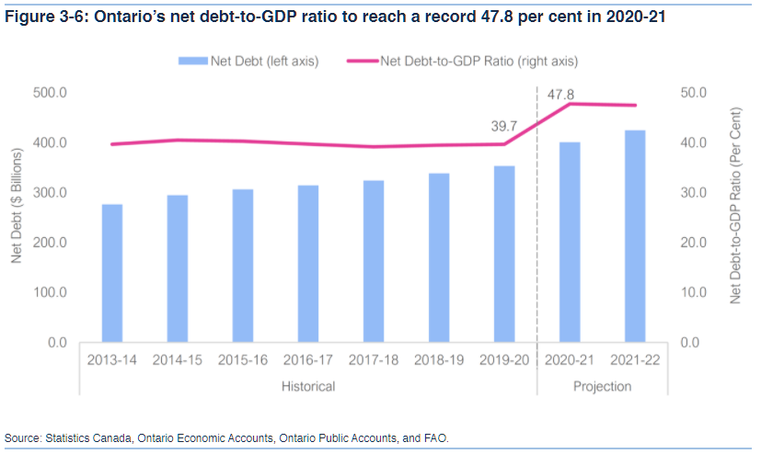
Public services and public sector workers are going to be in some trouble for years to come!

Slide 30
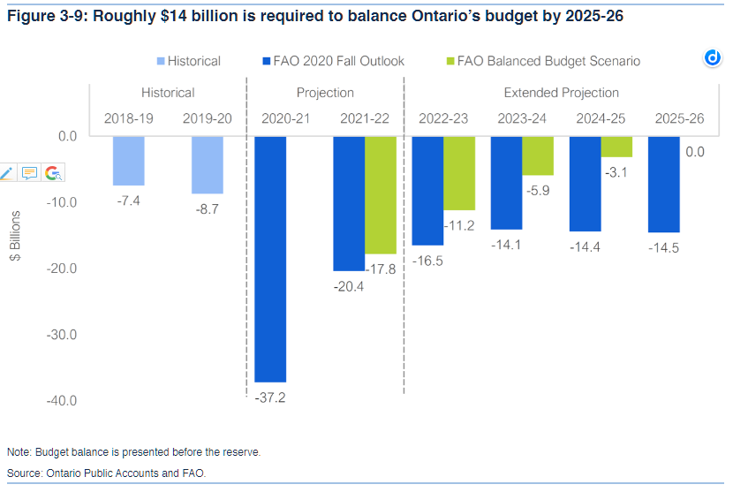
Huge increases in taxes or cuts in programs needed to balance budget in five years

Slide 31
$14.5 billion
That is the dollar amount needed to be found by 2025-26 to balance the budget according to FAO
Revenue increases or program cuts
Achieving revenue increases with this government will be a major challenge
If cuts: On a proportionate basis, government would cut about $5 billion from health care

Slide 32
Mitigation?
Over $9 billion in special funds and contingency funds not yet allocated.
Government may not spend all it budgeted this year.
Deficit could be significantly less than $37.2 billion.
It and the debt will still be very much higher than it was.

Slide 33
Challenges
Austerity between 2010-2019, following the Great Recession
Then, over a decade after the 2008-9 recession the government enacted legislation to ensure sub-inflation wage increases for broader provincial public sector workers for three years – before COVID even raised its head
0.25% decline in 2008 followed by 3.5% decline in 2009, before growth resumed in 2010
Larger economic decline than this time around?

Slide 34
Austerity and attacks on public sector collective bargaining followed previous recessions
1980-81 recession – Public sector collective bargaining over-ridden in most parts of the country following recession.
1991-1992 recession – Public sector collective bargaining over-ridden in all provinces following recession Rae Days in Ontario.
Followed by harsh austerity of Mike Harris – especially focused on hospitals up until 1998.

Slide 35
Worse after COVID-19 recession?
Economic decline this time around may be over quicker, but may well be bigger than the Great Recession
Deficits forecast to be much bigger. Debt larger.
In 2019, ten years after the last recession ended, we were not even over the attacks that arose from it (e.g. 3 year 1% cap imposed by Ford on settlements before COVID hit).
Longer than a decade for a public sector recovery after COVID?
Compounding the problem: Long-term decline in rate of economic growth since 1950s.

Slide 36
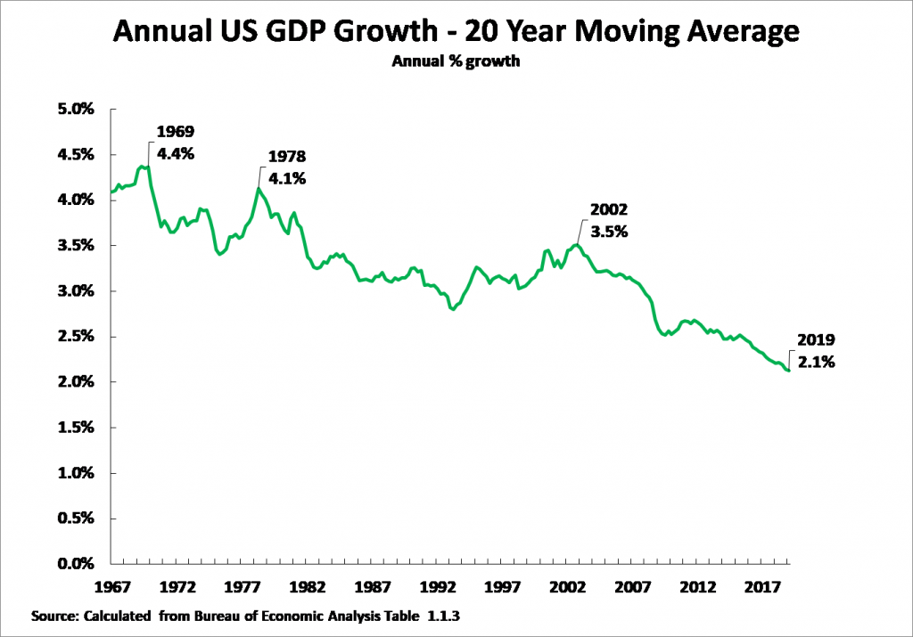
Long-Term Decline in Growth
Strongest developed capitalist economy (USA) has seen decline in annual average economic growth since the 1950s.
From over 5% to 2.1%.
This chart shows a moving 20-year average to (mostly) eliminate cyclical swings in a given year.

Slide 37
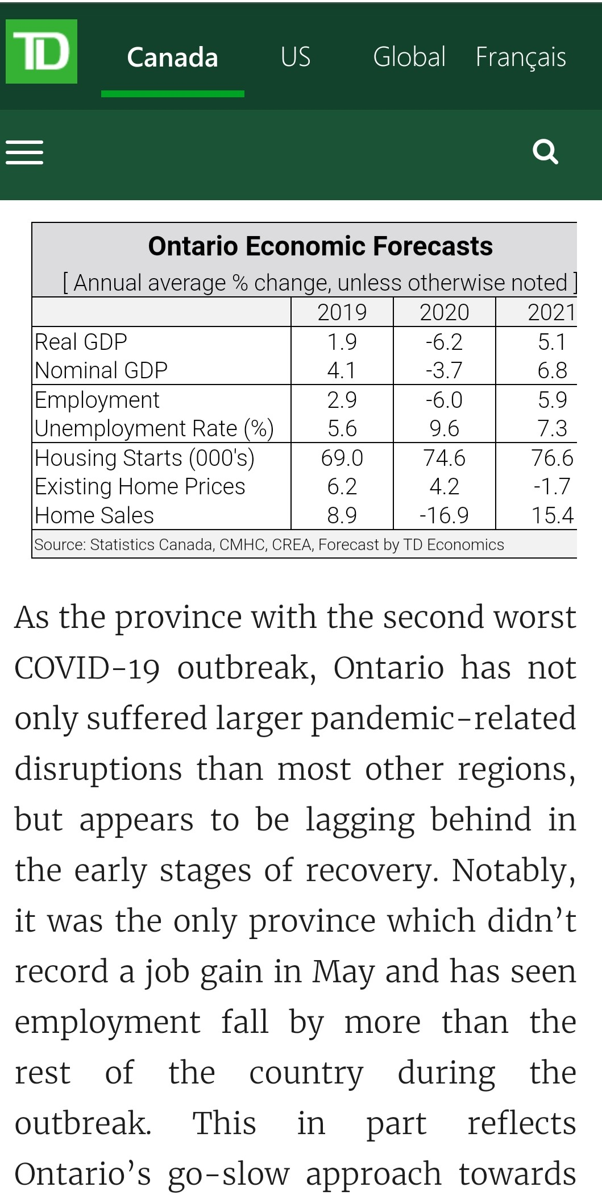
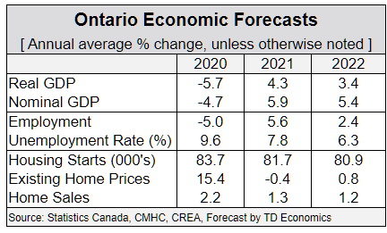
TD Economic Forecast
Previous forecast: -6.2% in 2020. Newer (mid-September) forecast: negative 5.7%.
But growth over 2020 and 2021 is now forecast to be worse. Was Negative 1.4% growth, now negative 1.65%.
Smaller drop – but smaller recovery.
Warn that second wave could “slow momentum”.

Slide 38
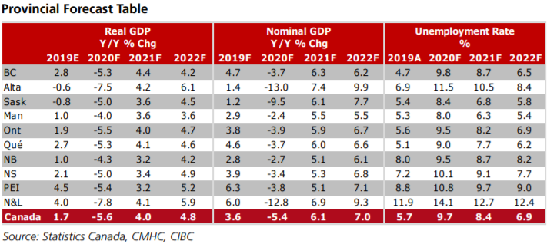
CIBC: Negative 1.7% growth over 2020 and 2021
Slightly better than previous forecast of -2%

Slide 39
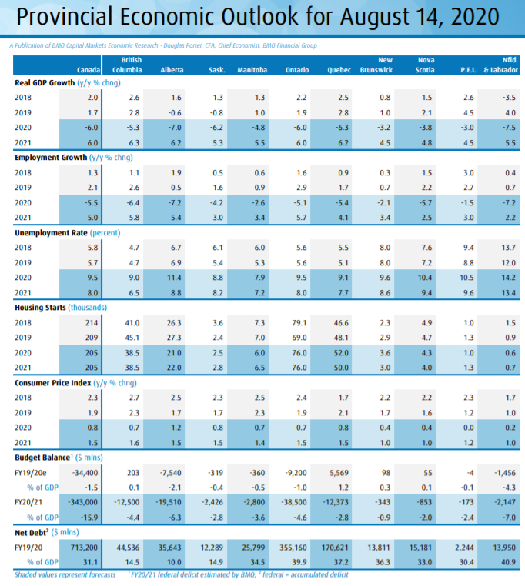
BMO Ontario Forecast (Mid-august)
2020 and 2021 growth = negative 0.36%, same as Canada as a whole.
Inflation forecast at 0.8% in 2020 and 1.5% in 2021.
Deficit forecast at $38.5 Billion, 4.6% of GDP, up from 1%.
Like other forecasts, made before advent of second wave.

Slide 40
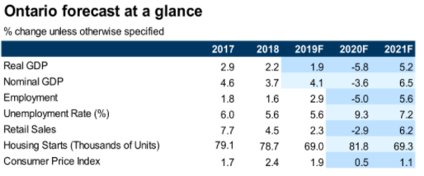
RBC Ontario forecast – September 10
2020 and 2021 GDP: negative 0.9%.
Inflation – 0.5% in 2020 and 1.1% in 2021.
Nominal GDP up 2.6% over 2020 and 2021. About
6% below normal trendline.

Slide 41
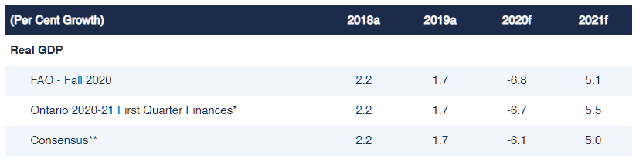
FAO estimates are a little more pessimistic

Slide 42
2020 and 2021 “Growth”
FAO: Negative 2.05%.
Government: Negative 1.15%.
Banks and private sector forecasters (“Consensus”): Negative 1.4% .

Slide 43
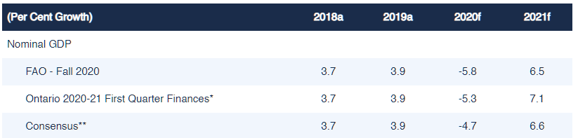
2020 and 2021 Nominal Growth
FAO = 0.3% growth
Consensus = 1.6% growth

Slide 44
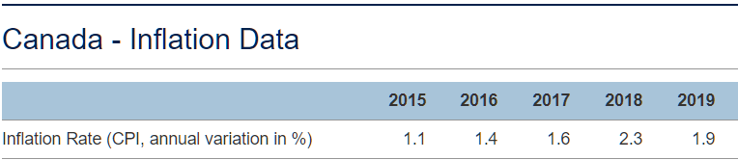
Inflation?
In a fundamentally new and unpredictable situation.
Focus Economics: “Inflation remains stubbornly low in August. … Meanwhile, annual average inflation ticked down from 1.3% in July to 1.2% in August.
“Commenting on August’s inflation reading, Benoit P. Durocher a senior economist at Desjardins, noted: “The after effects of the lockdown and weaker demand in some sectors have not finished leaving their mark on inflation. There is therefore every indication that the total annual inflation rate will stay below the lower target (1%) for some months to come. This will prompt the Bank of Canada to keep monetary policy very accommodative.”
Focus Economics Consensus Forecast analysts, see inflation averaging 0.5% in 2020, which is down 0.3 percentage points from the previous month’s forecast. For 2021, our panelists see inflation averaging 1.6%.

Slide 45
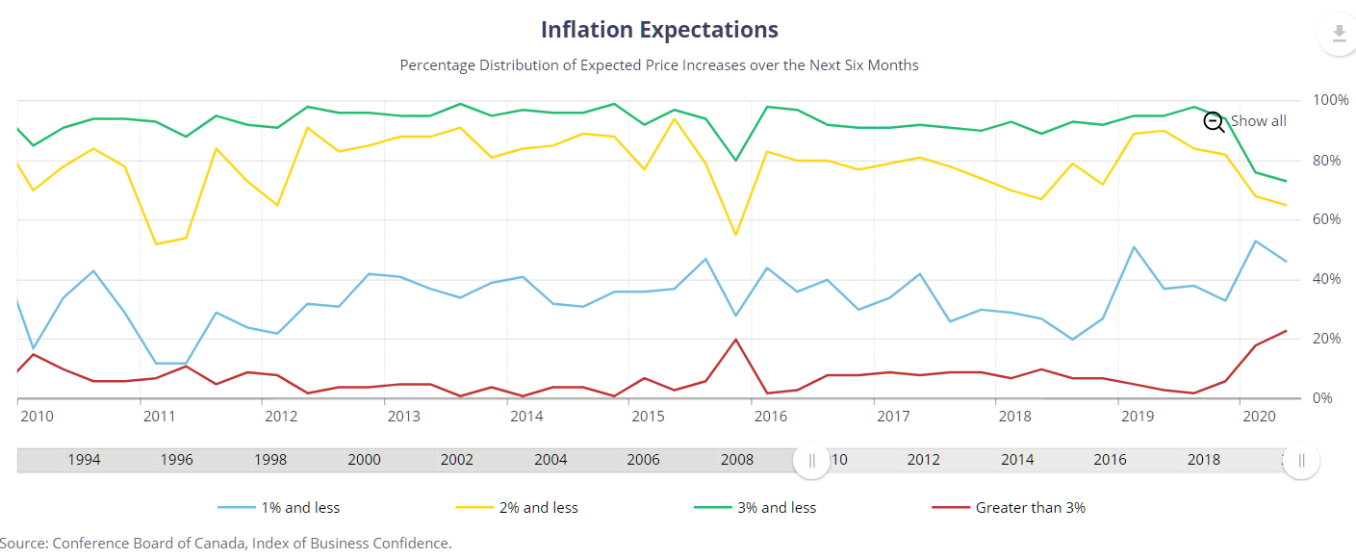
Bank of Canada – Inflation Expectations
Much uncertainty within corporations about where inflation is going – even just six months from now.
Many more firms think 1% and less (over 50%).
But growing number believe it will be over 3% (almost 20%).

Slide 46
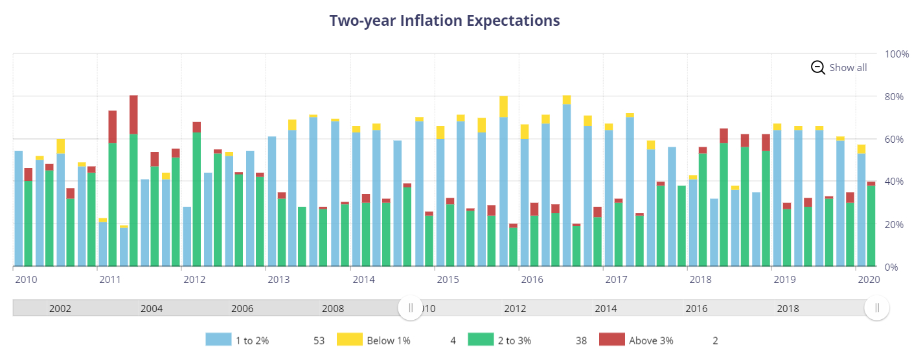
Two year inflation expectations?
More expect 2% or more.
Fewer expect 2% or less – but they are still in the majority.

Slide 47
And after COVID?
We face huge provincial deficits and debt
Big corporations will favour cuts in services rather than more taxes on corporations and the wealthy
Economic decline will be very significant
Expectations for economic growth are very moderate

Slide 48
Unprecedented situation
Declining long-term economic growth
Increasing inequality
Major fall in economic activity. By end of 2021 GDP may be about 5% behind normal trendline (negative 1% GDP over 2020 and 2021 compared with 4% trendline growth over that period)?
Will growth return to normal levels? Very uncertain economic future
Inflation, economic growth over 2021-25 more uncertain than usual
Huge government debt and deficits
New, expanded role of federal government and its spending powers. New levels of federal deficit

Slide 49
We are in trouble

Slide 50
Two-fold response?
Increase revenues
Increase growth
Capitalist growth is failing

Slide 51
Any good news?
Unprecedented profile and sympathy in 2020 for health care and health care workers, especially regarding LTC
Shortage of PSWs: Recruitment and retention recognised as urgent by ruling circles to stop widespread LTC resident death during second wave.
PSW temporary wage adjustment.
Private sector settlements in 2020 have continued at or slightly above inflation.

Slide 52
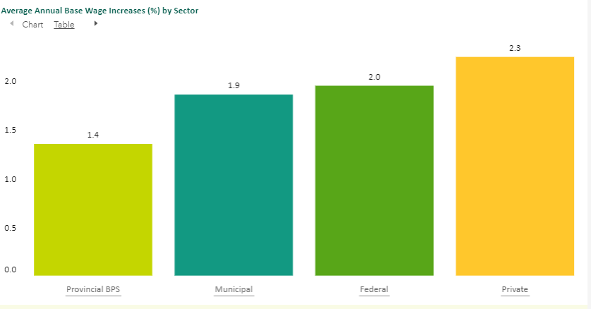
Settlement trend 2019

Slide 53
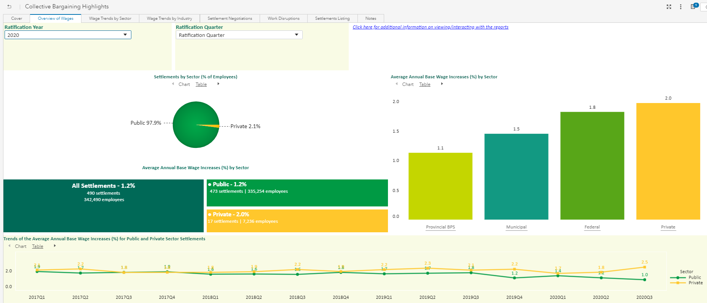
Settlement trends 2020 through September

Slide 54
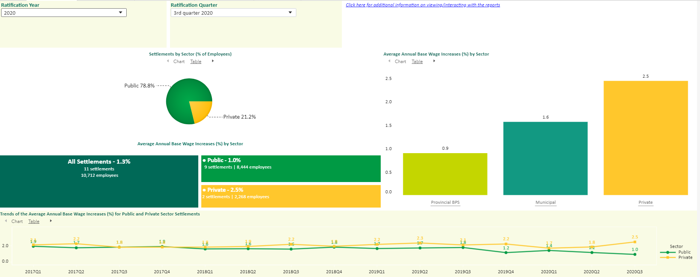
Settlement trends: 3rd quarter

Slide 55
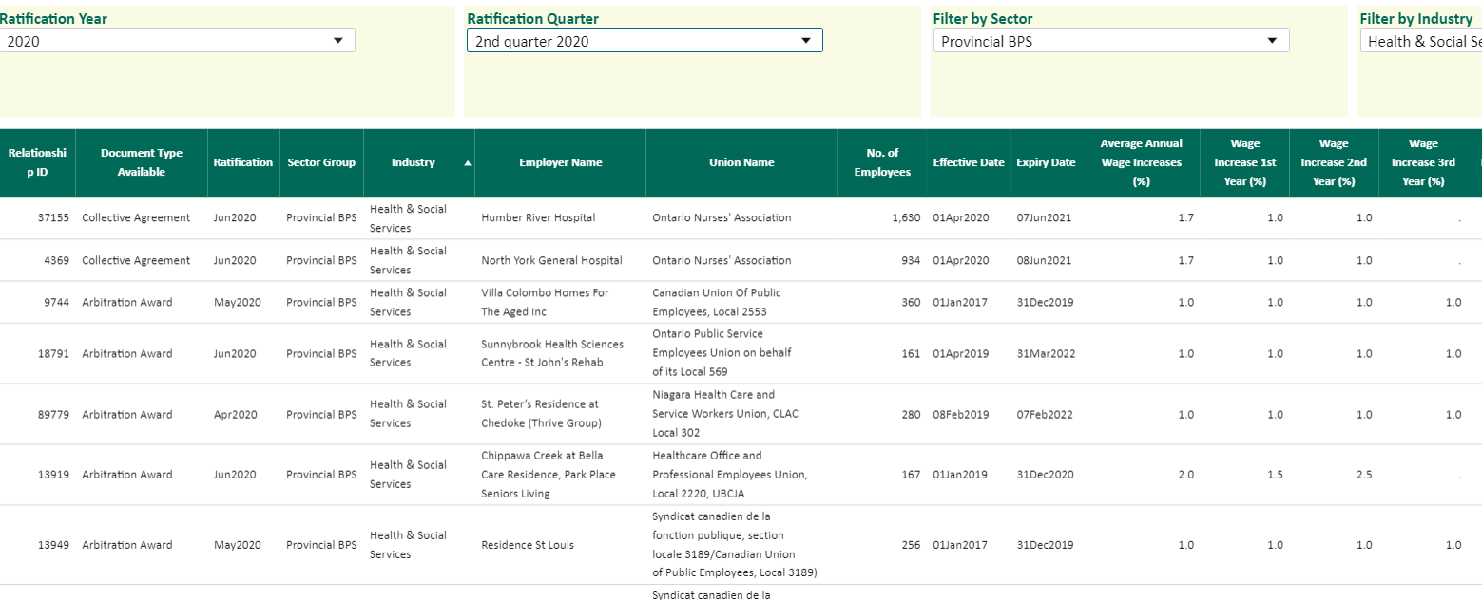
2nd quarter 2020 Health and Social Service settlements (Excluding ONA Hospital)

Slide 56
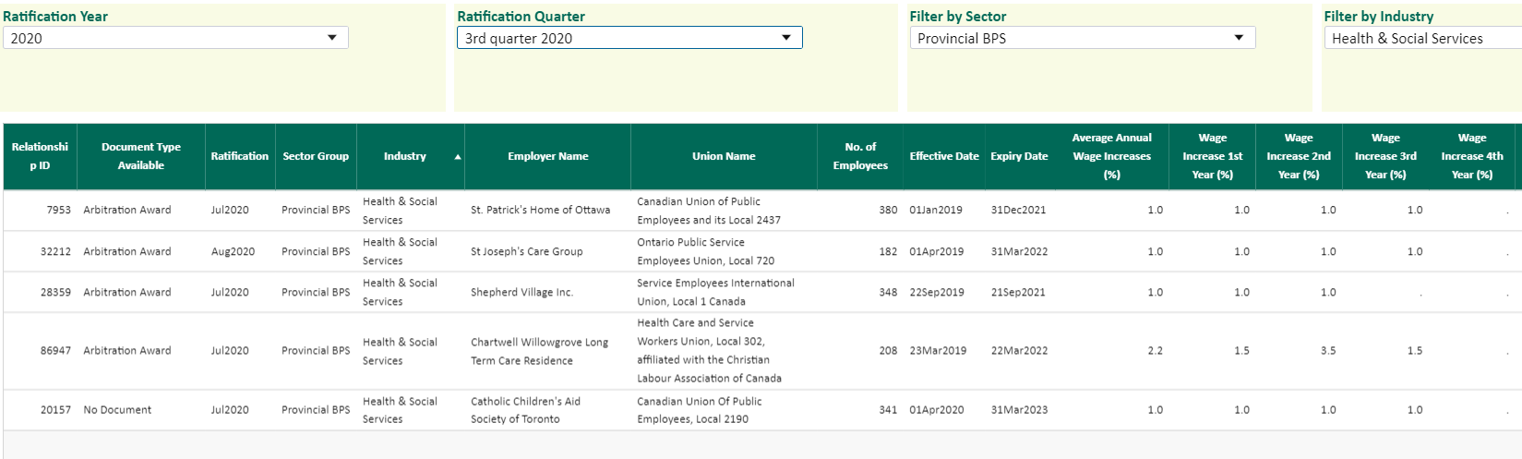
3rd quarter 2020 Health and Social Service settlements

Slide 57
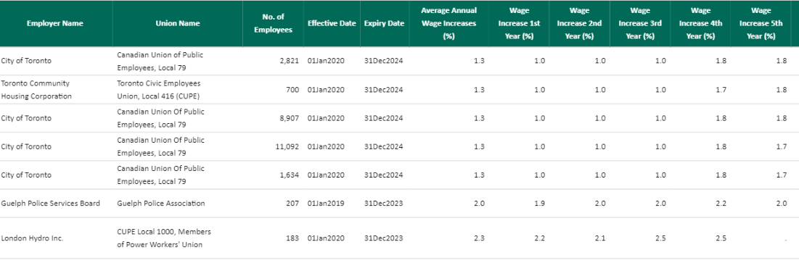
Municipal 2nd and 3rd quarter 2020 settlements
Longer agreements – back end loaded

Slide 58
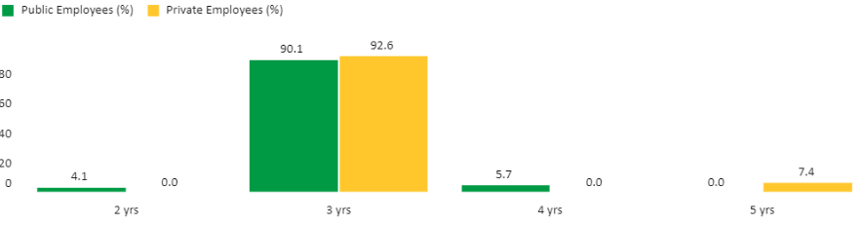
Length of contracts ― 2020 settlements

Slide 59
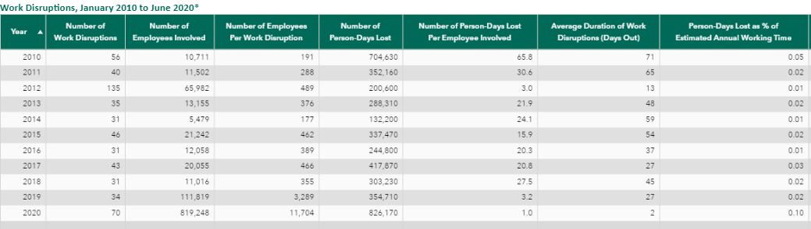
Strikes and lockouts

Slide 60
Settlements: Comment
Huge disparity between broader provincial public sector and private sector settlements.
Consistent with 1% cap on BPS settlements.
Gap may be deepening.
Also a more modest gap between broader provincial public sector and municipal public sector.
Some five year municipal settlements.
Much more strike activity in 2020 than trend – teachers in early part of the year.

Slide 61
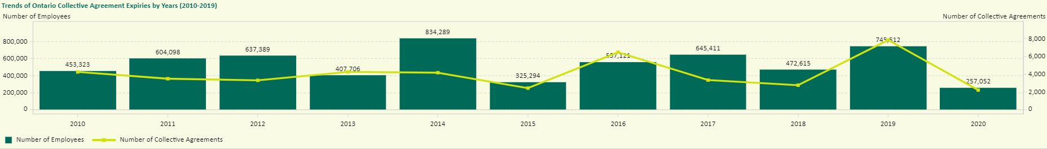
Fewer expiring agreements in 2020

Slide 62
Major Expiring Agreements
2020
  March — ONA/Hospitals (64,400 employees) (Award)
  31 March – Ontario Hydro – Power Workers
  April — WSIB-CUPE (3,300 employees)
  June — U of T / Steelworkers (6,000 employees)
  August — York University / CUPE (3,300 employees, three agreements)
  September — “Big 3” automakers / UNIFOR (20,000 employees total)
  Dec 31 -- U of T – CUPE 3902 (7,000 members)
2021
  31 January — College — Part-Time Support Workers — OPSEU
  31 March — LCBO — OPSEU
  31March – Ontario Power – PWU (6,449 members)
  June — Bombardier / UNIFOR (1,600 employees)
  September — GM Cami Assembly plant / UNIFOR (2,500)
  28 September — CUPE Hospitals
  30 September — Colleges / OPSEU (College Professors)
  31 December — Ontario government (OPS) — OPSEU
OPSEU — Hospital paramedicals — 31 March 2022

Slide 63
Bill 175
Three forms of hospital privatization.
Private Hospitals Act amended to allow more beds.
Home care corporations allowed to operate in hospitals.
Residential congregate care regulations to take over hospital work — e.g. rehabilitation and transitional care.
Direct attack on hospitals.
Also privatizing LHINs care coordination and direct home care services.

Slide 64
Bill 175 – hospital privatization
Unlicensed non-hospitals to take over “transitional”, “ALC”, rehabilitation and other forms of hospital inpatient care.
Home and community care businesses and organizations to provide care.
Home care providers often for-profit corporations.
Low wages, low benefits, few pensions, often for-profit.
Sunnybrook, Oshawa, Ottawa.
We need to identify where this is happening as soon as possible.
Strategy to achieve successor rights and keep work in hospitals.

Slide 65
Hospitals – what are they good for?
Attempt to limit them to only acute care services.
Dis-integrate care.
Should provide full range of hospital services – acute, rehab, CCC, post-acute, mental health, out-patient clinics, day surgeries, LTC, primary care, home and community care.
That would be health care integration.
Key goal of our opponents: entrench and deepen the wide discrepancy in wages and working conditions in different health care sub-sectors.
Our role is to ensure fair conditions in all sub-sectors.

Slide 66
Thank you
Doug Allan
CUPE Research

