Slide 1
Racism, Health Inequity and COVID-19
Sané Dube
Policy & Government Relations Lead (Black Health)
sane.dube@allianceon.org

Slide 2

What we know
COVID-19 doesn’t flatten disparities; it amplifies them
Inequities that existed before COVID have gotten worse during the pandemic
Structural inequality explains what we’re seeing with COVID
“Inequities put many racialized and immigrant populations at higher risk of both contracting the infection and suffering poor outcomes.”- (ICES)
Photo by Adam Nieścioruk on Unsplash

Slide 3
“Equity is the absence of avoidable, unfair, or remediable differences among groups of people, whether those groups are defined socially, economically, demographically or geographically or by other means of stratification. "Health equity” or “equity in health” implies that ideally everyone should have a fair opportunity to attain their full health potential and that no one should be disadvantaged from achieving this potential.”
-World Health Organization

Slide 4
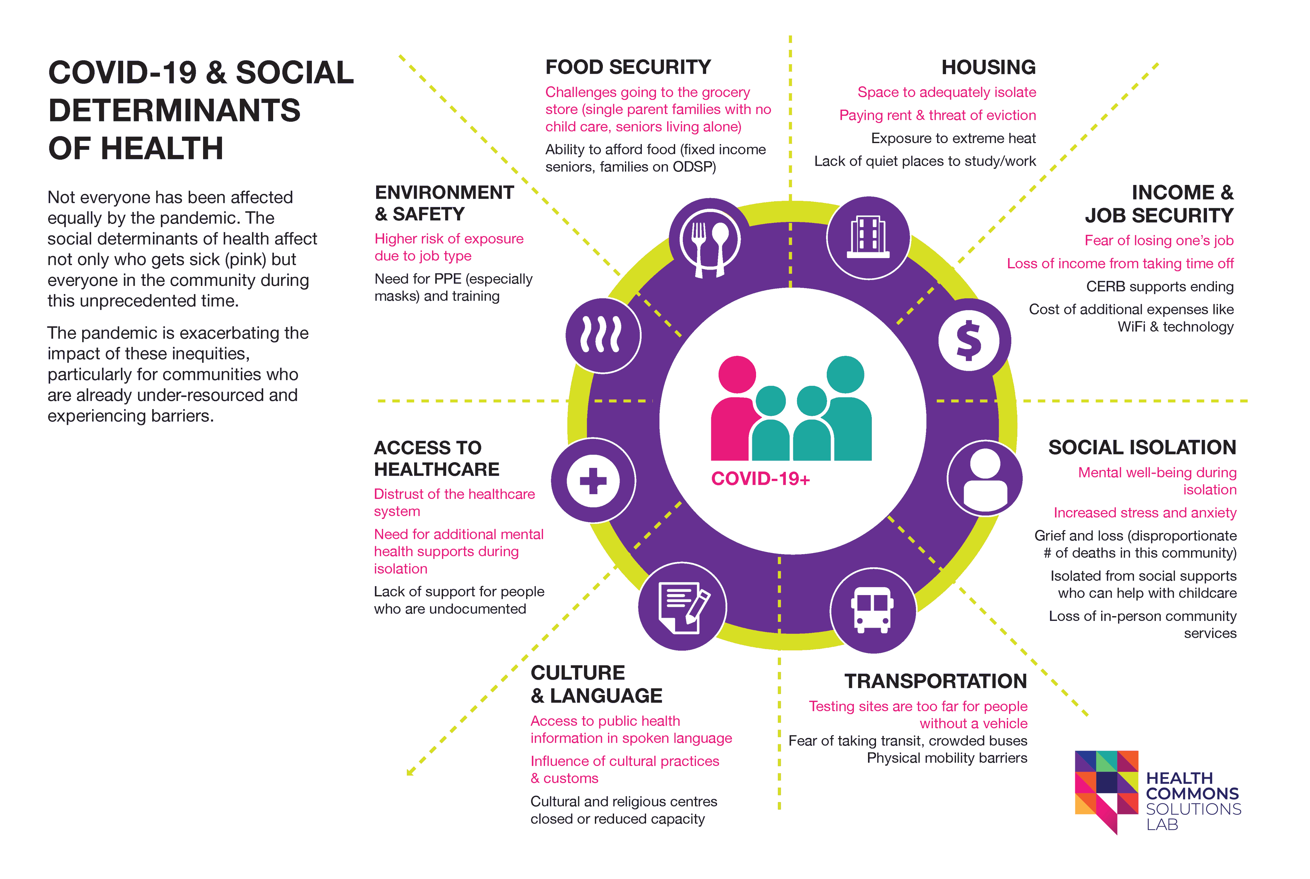
Source: Health Commons Solutions Lab

Slide 5
Who is COVID impacting in Ontario?
Covid-19 cases and deaths concentrated in areas with high material deprivation, and in neighbourhoods where primarily racialized people live
Immigrants, refugees and other newcomers make up 25% of the ON population, but 43.5% of all COVID-19 cases
Data from July 2020 found that 83% of COVID-19 cases in Toronto among Black and racialized people
COVID affecting disproportionately impacting Black and racialized people with worse outcomes

Slide 6
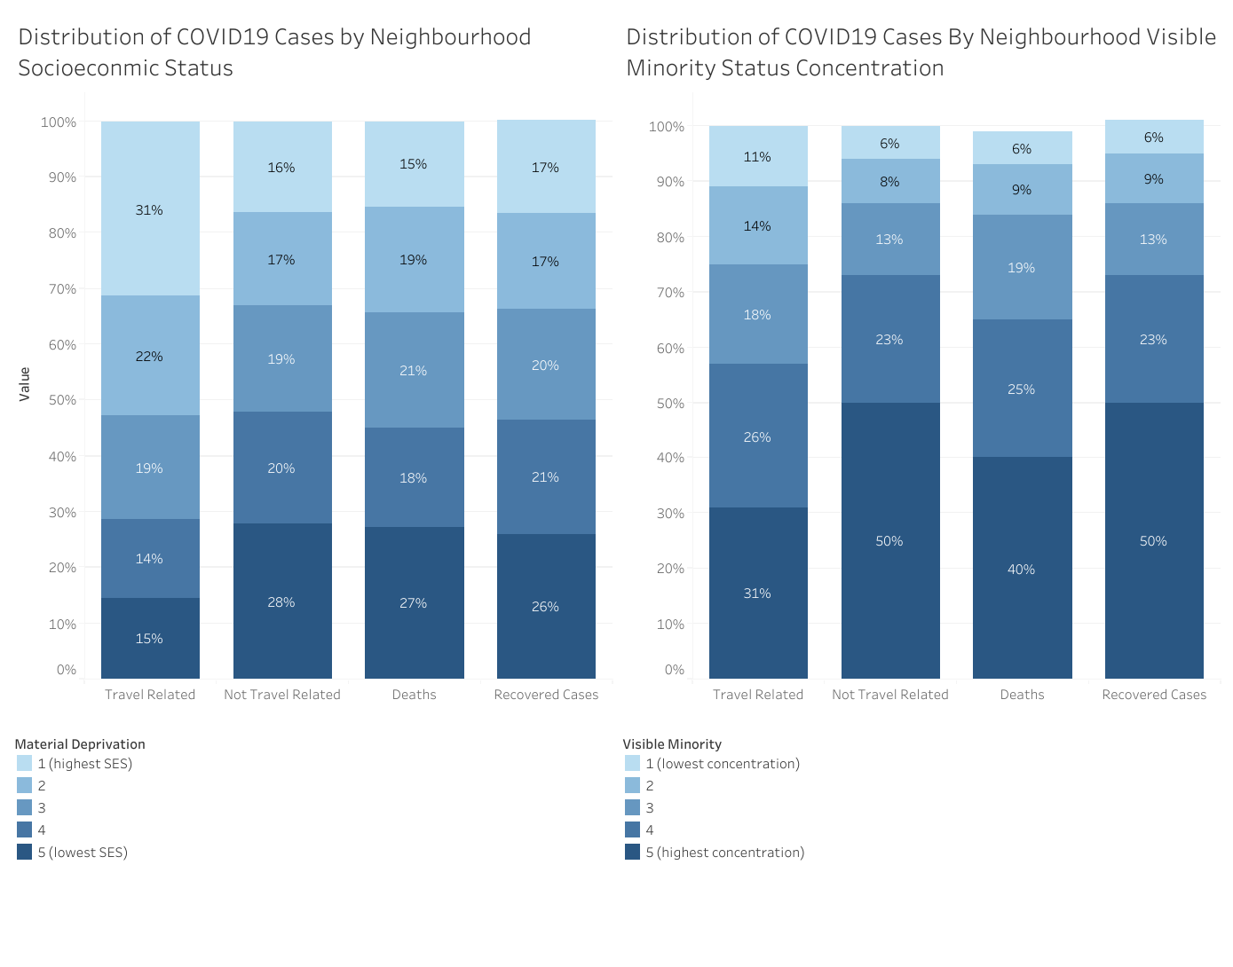
Source: https://howsmyflattening.ca/#/analysis/socioeconomic_analysis/

Slide 7
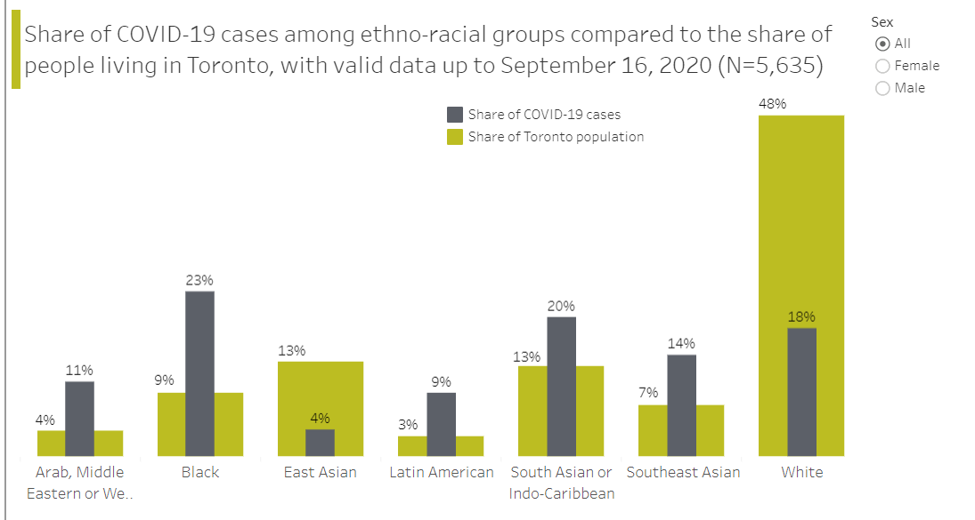
Toronto Data: COVID and Race
Source: https://www.toronto.ca/home/covid-19/covid-19-latest-city-of-toronto-news/covid-19-status-of-cases-in-toronto/

Slide 8
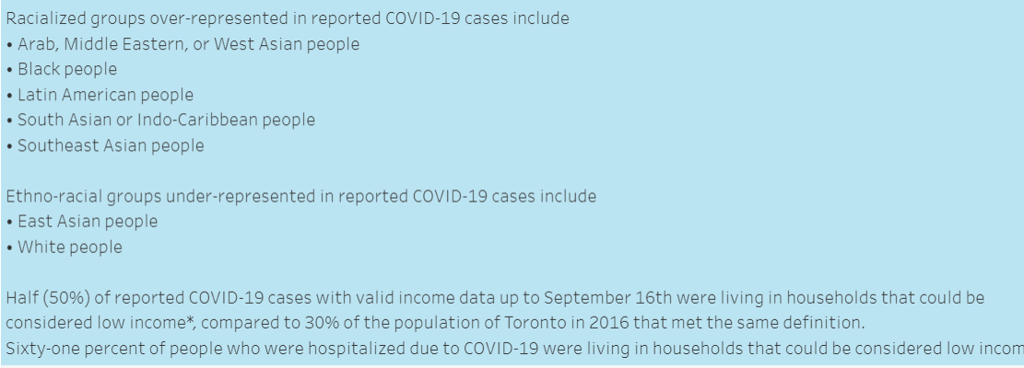
Toronto Data: COVID and Race
Source: https://www.toronto.ca/home/covid-19/covid-19-latest-city-of-toronto-news/covid-19-status-of-cases-in-toronto/

Slide 9
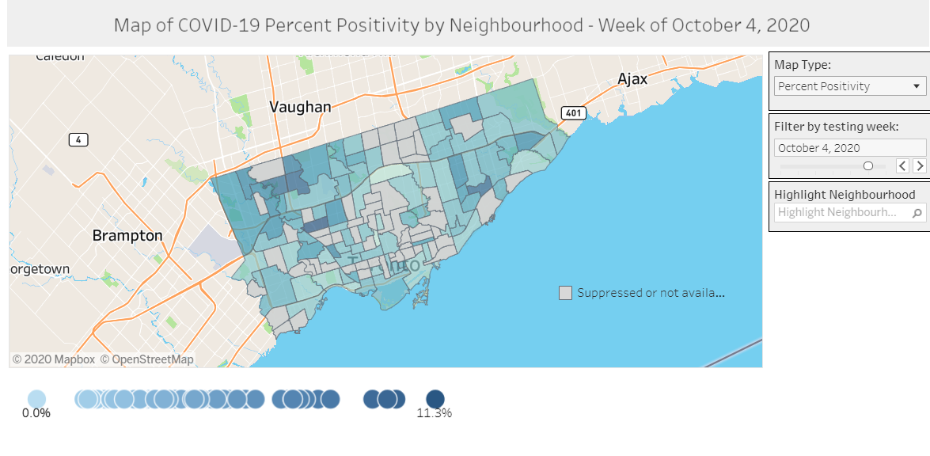
Neighbourhood Positivity Data, Toronto
Source: https://www.toronto.ca/home/covid-19/covid-19-latest-city-of-toronto-news/covid-19-status-of-cases-in-toronto/

Slide 10
“We have always understood that a plethora of factors affect health outcomes for Black populations in the province. “Good health” is a product of access, social, cultural and economic factors. Similarly, structural and systemic inequalities are contributors to poor health outcomes. Ontario is home to the largest proportion of Black people in Canada. Here too, as in the rest of Canada, race is a determinant of health.”
-Statement from Black Health Leaders on COVID-19’s impact

